Slide 1
Muhamad

Slide 2

Social Media Extremism Detection
Ruben Vandamme & Muhamad Khatib
Student-ids: 936753 & 941094
Advanced Machine Learning (F1801Q151)
Prof. Simone Bianco & Prof. Vincenzina Messina
Academic year 2025-2026
Department of Computer Science, Systems and Communication (DISCo)
2e Master in Informatics

Slide 3
What is the challenge about?
Extremism is subtle, context-dependent, and constantly evolving
Anonymized dataset of social media posts
Educational and research-based
Accuracy as a judge
Notes:
Online platforms struggle to balance free expression with the need to reduce harm from extremist content.
Detecting such content at scale is difficult: it is often subtle, context-dependent, and constantly evolving.
In this challenge, a specialized research team provided an anonymized dataset of social media posts.
Each post has been labeled as either EXTREMIST or NON_EXTREMIST based on whether it clearly supports or promotes extremist organizations, ideologies, or violence.
By building models that can identify this content, participants contribute to research on safer online environments and more responsible AI systems.
This competition is educational and research-oriented. It is not intended to be a complete production system, but rather a sandbox to explore modeling choices, fairness, robustness, and interpretability.
The final score to judge how well the model does is chosen specifically as accuracy.
In other words perfect for a university project. It looked interesting and would provide enough challenge (not just the simple neural network example) while still keeping things in scope of the course.

Slide 4
The Dataset
Train (2250 texts + label), Test (IDS for prediction), Example Submission
Anonymized, English-language social media posts -> Hate Speech Detection Curated Dataset
Already normalized
Hand-labeled into extremist or not -> significant harm, support of extremist organizations, or promoting violent ideologies
Notes:
The provided files are:
A Training file, containing 2250 message texts and their corresponding label.
A Test file, containing a message text with IDs for prediction and thus submission to Kaggle.
And an Example Submission file, showing the expected output format.
All texts are anonymized, English-language social media posts sourced from a larger database of over 400,000 messages, specifically the Hate Speech Detection Curated Dataset.
While not mentioned anywhere, it seems this dataset was already normalized beforehand including case folding, punctuation stripping and de-accenting.
A research team hand-labeled the posts.
The authors state that human error is possible.
A post was classified as extremist if it clearly advocated for significant harm, supported extremist organizations, or promoted violent ideologies.
Of those 2250 Texts, 1150 are labeled for the presence of extremism at (52%) and 1100 for absence at (48%).
We will get back to this later but the test set was not having the same balance.
(ALL EXTREMIST 0.2240 <- dont say)

Slide 5
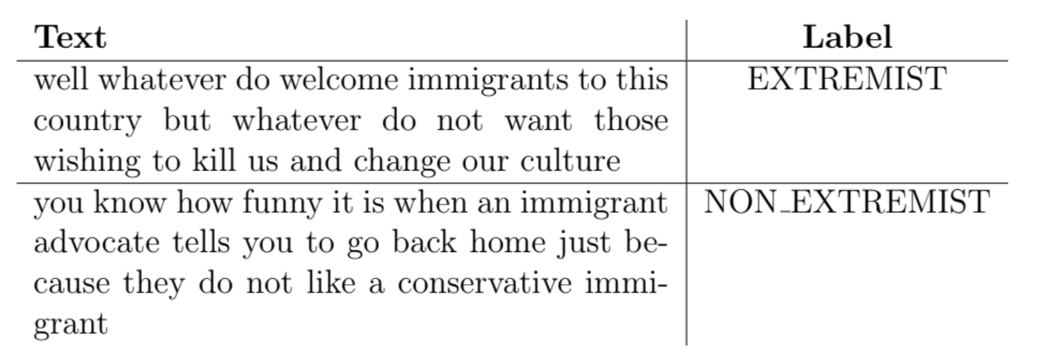
The Dataset

Slide 6
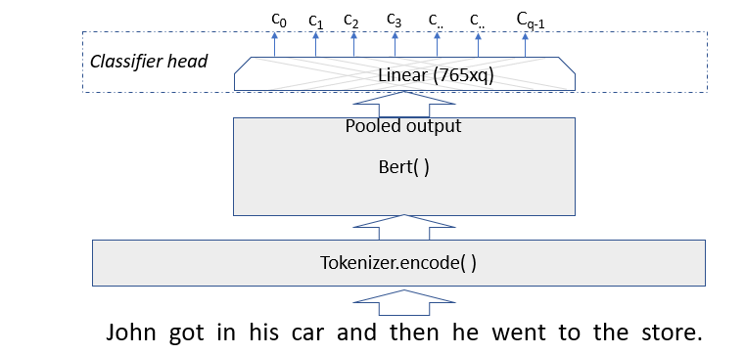
Prototype Concept
BERT-style transformer body with + small linear classifier head
BCE, AdamW (LR=1e-5)
Early stopping with patience 3, saving best
Frozen -> Unfrozen
https://esciencegroup.com/2020/02/20/modeling-natural-language-with-transformers-bert-roberta-and-xlnet/
Notes:
The base model consists of a BERT-style transformer body with a small linear classifier head.
The body is obviously pretrained, while the head is trained from scratch, and will combine the BERT Embeddings output as well as learn what extremism is.
Binary Cross Entropy is used as the loss, and AdamW as the optimizer, with a low learning rate of 1e-5, to fine-tune the body slowly, and avoid destroying pretrained knowledge.
Overfitting is a risk, due to the small dataset, and millions of parameters, so weight decay and early stopping (patience = 3 epochs) are applied, and only the model with the lowest validation loss is saved.
Initial runs with a frozen body, yielded about 60% accuracy, highlighting the need to unfreeze the transformer to allow gradients to update its weights.
Now the original model is being Fine-Tuned to the problem and slightly different language style, instead of just using feature extraction.
The accuracy increased to about 70%.

Slide 7
Ruben

Slide 8
Validation loss VS accuracy + BERT
Measuring performance using accuracy -> model not generalizing well
Loss instead -> more representative and stable
Deciding the version -> test accuracy (captures good generalization best)
BERT, RoBERTa, HateBERT and BERTweet
HateBERT not covering broader linguistics
Notes:
There are multiple experiments that we tried in order to improve upon this prototype concept. A first thing to note is how we measured performance. At first we just looked at the accuracy, but after doing some submissions in Kaggle, we noticed the results were different. Some higher accuracy on the validation (by the way we used an 80-20 split) gave lower accuracy on the test and opposite. We realized that the model was not generalizing well so instead we looked at the validation loss which was more representative and stable. This was just for training purposes. For finally deciding which specific version to go with we looked at the test accuracy, as it captures good generalization the best.
Anyways, the first main experiment was trying out different flavours of the BERT model, and not just use the basic one. We also tried RoBERTa, HateBERT and BERTweet which were trained on a dataset with domain more closely related to our problem. RoBERTa and BERTweet performed best, with HateBERT surprisingly bad. Probably because it does not fully cover broader linguistics found in extremist posts. It was trained too much on ónly hate speech. Also hate and extremism are not the same.

Slide 9
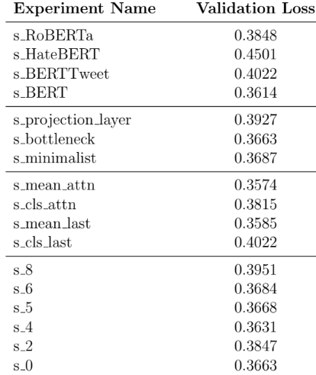
Head Architecture + Dropout
Simple head sufficient -> body already captures majority task-relevant features
Notes:
As for the model structure, there were 3 more experiments. For the head architecture, we noticed it was sufficient to keep it small and simple. Not a lot of complex relationships are to be discovered because the transformer body already captures the majority of the task-relevant features.
Here you can see that we also added a dropout layer, with an optimum around 0.5, leading to a 3% increase. It is also another proof that regularization was desperately needed.

Slide 10
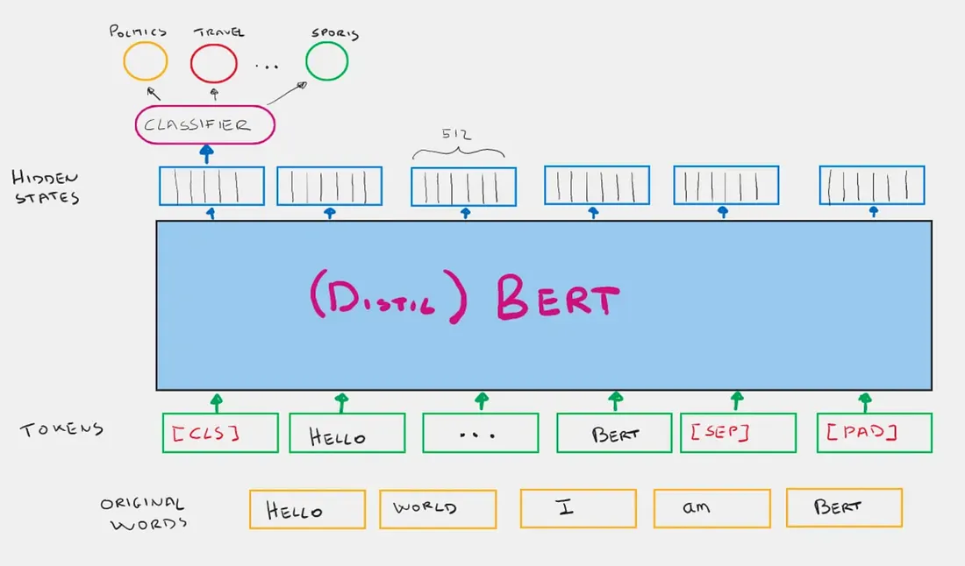
Pooling
CLS: aggregate meaning of sentence using self-attention
Pre-train bias
Retrain by unfreezing, but…
Mean pooling?
Mathematical average vectors
Presence even if attention elsewhere
https://aditya007.medium.com/understanding-the-cls-token-in-bert-a-comprehensive-guide-a62b3b94a941
Notes:
Finally we read something interesting about the BERT transformer that delves a bit deeper into how it works and is more research based. It was difficult, and still kind of is, to understand but as the transformer was such a big part of the project we wanted to include it.
When a transformer processes text, it outputs a vector for every single word in the input. However, a classifier requires one fixed-size input to make a decision. Pooling is the bridge that turns a sequence of many vectors into that one necessary summary.
In BERT, a special token CLS (classification) is added to the start of each sentence which will be used for pooling. The model is trained to aggregate the overall meaning of the sentence into this specific vector. It does this by applying self-attention. However, the dataset was Wikipedia, where for example the word ‘die’ is treated less important as it is just another fact (pre-train bias). But we have social media texts, and we want to put a lot of attention to that word. One way to re-train self-attention was unfreezing which gave good results. So now maybe we can complement it by using mean pooling? Mean pooling takes the mathematical average of all these vectors for each word. Because ‘die’ has a very distinct high magnitude in certain dimensions, its presence will shift the entire average of the sentence, even if the model's attention was focused elsewhere, so it can’t be ignored.

Slide 11
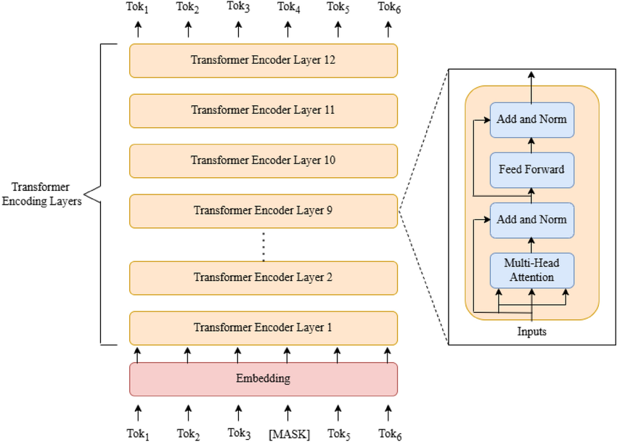
Pooling
12 layers, usually just last
May be too specialized -> last 3
Cls_last, mean_last, cls_attn and mean_attn
Mean pooling slightly better
https://www.researchgate.net/publication/393321304_Comparative_analysis_of_model_compression_techniques_for_achieving_carbon_efficient_AI
Notes:
Another related thing is that transformers consist of multiple stacked layers (12 layers for BERT-base), and typically we just use the last layer as that makes the most sense; contains the most refined, abstract features intended for the task. However instead we could look at the last three layers too. This might be useful as the last layer can be too specialized. We allow the model to choose which layer to put most attention to. Thus we arrive at the 4 listed experiments. Mean pooling tended to outperform CLS pooling slightly, but the results for attention-based layer aggregation or not were too similar to make conclusions.

Slide 12
LR + Data Augmentation
Small learning rate both -> separate -> warm-up schedule -> …
Impact minimal
Back Translation, NER Entity Swapping and Adversarial Smart Swapping
Contextual word substitution, random insertion, swap, deletion, .. better
Targeted entity-level augmentations <-> diverse lexical and structural variations
Notes:
In the base model, the same small learning rate was used for both the transformer body and the classification head. We tried separating the learning rate and using things like warm-up schedules and while it was more stable, their impact on the final accuracy was minimal. We also tried data augmentation as the small size of the dataset was obviously a big bottleneck. Backtranslation, NER entity swapping, and adversarial smart swapping were applied. While we expected a lot from this, the results were meager. After doing some research we noticed contextual word substitution, random insertion,
swap, deletion, etc yielded more substantial improvements. So instead of targeted entity-level augmentations introducing diverse lexical and structural variations is more effective for generalization in this case.

Slide 13
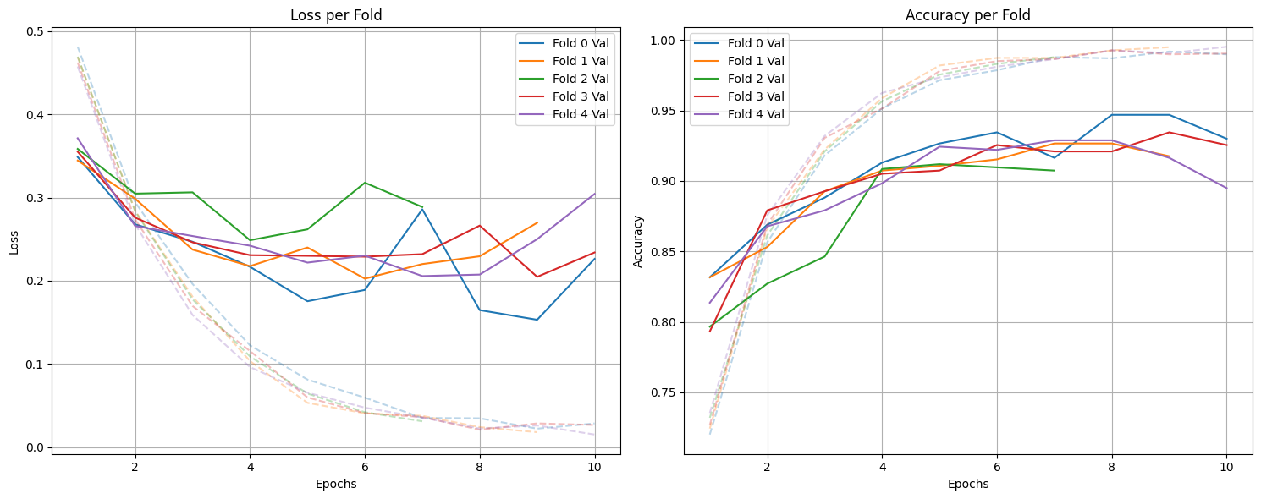
CV + Weighted Learning
5-fold cross-validation with soft voting
Clear consistent improvement
Test set balance different from training set
More importance to non-extremist examples
Notes:
Just two more experiments. A five-fold cross-validation with soft voting encouraged the model to learn patterns that generalize better and reduce overfitting. Also just to make use of all the data. This led to a clear and very consistent improvement.
Finally, if you remember we talked that the test set had a imbalance compared to the training set? To account for this, kind of a cheat to boost accuracy, weighted learning, adjusting the loss weights during training, giving more importance to non-extremist examples, was used.

Slide 14
Final Model…?
Combining best versions will result in a phenomenal model right?
Not so much: 73%
Adjustments influencing each other
Highest found: 77%
Without better Data Augmentation highest possible: +-80%
Notes:
Now, I will admit we were very naive. We expected that if we took the best version of each experiment and combined them all, we would have a very good model. However the results were worse than before even. Coming in at 73% accuracy while we expected about 80. This meant we took place 40 out of 164 contestants. Not bad but still. We didn’t account for the fact that different experiments would influence each other in complex ways. Even after testing some more different combinations, the highest achievable was 77%. This does suggest however that without better data augmentation because we tried so many things, the highest achievable is probably about 80%.

Slide 15
Lessons Learned
Choosing a good transformer model for the problem is essential. The head classifier is often quite simple. Changes to this known setup/architecture are not often impactful. Better to find improvements elsewhere.
Validation loss can be a better metric than validation accuracy, even though high accuracy is what is wanted.
Data augmentation is tricky and requires care and understanding.
Notes:
To summarize our gained experience for this project:
Choosing a good transformer model for the problem is essential. The head classifier is often quite simple. Changes to this known setup and architecture are not often impactful, better to find improvements elsewhere.
Validation loss can be a better metric than validation accuracy, even though high accuracy is what we need.
Data augmentation is tricky and requires care and understanding

Slide 16
Lessons Learned
Cross-validation is almost always a good thing to do, as well as adding some dropout regularization.
Understanding of NLP for classification using a text transformer like BERT.
Optimization is complex. Summing distinct well-performing changes will not necessarily lead to a good model.
Notes:
To summarize our gained experience for this project:
Cross-validation is almost always a good thing to do, as well as adding some dropout regularization
Understanding of NLP for classification using a text transformer like BERT
Optimization is complex. Summing distinct well-performing changes will not necessarily lead to a good model.

Slide 17

Discussion

